Slide 1

CAREFLOW – CLINICAL PATHWAY PROCESS MINING (final-Review)
Team Members
Anagha S Pillai
Yashaswini N P
Vaishnavi Dipak Bhagat
Infotact Solutions – Data Analytics Internship

Slide 2

Introduction
CareFlow is an end-to-end healthcare process analytics and process-mining project built to understand patient journeys through hospital workflows using timestamped event logs.
Traditional dashboards provide aggregated KPIs such as patient counts and waiting times, but process mining helps reveal the actual sequence of activities, repeated steps, loop-backs and deviations experienced by patients.
The final project combines Python, Pandas, PM4Py, BigQuery, dbt and Power BI to discover workflows, identify process deviations, validate results and present process insights.

Slide 3

Problem statement and project objectives
Problem Statement
Hospital workflows involve multiple activities, but traditional dashboards mainly show numerical KPIs and may not reveal how patients actually move through the process.
Patients may experience:
Repeated activities & loop-backs
Different activity sequences
Waiting-time delays
Deviations from the expected workflow
Example:
Triage → X-Ray → Triage
This repeated activity indicates a potential process inefficiency requiring investigation.
Project Objectives
Analyze and clean timestamped patient event data.
Discover actual patient workflows using PM4Py.
Identify bottlenecks, loops and waiting times.
Generate DFG and Petri Net process models.
Perform conformance checking.
Investigate a simulated root-cause hypothesis.
Build and validate analytics using BigQuery and dbt.
Visualize findings through Power BI.

Slide 4

Project
Workflow
Hospital Event Data
↓
Data Generation
↓
Data Cleaning
↓
Exploratory Data Analysis
↓
Process & Waiting-Time Analysis
↓
PM4Py Process Discovery
↓
DFG + Petri Net
↓
Conformance Checking
↓
Root-Cause Investigation
↓
BigQuery + dbt Analytics
↓
Cross-Validation
↓
Power BI Dashboard
↓
Patient Drillthrough
↓
Final Process Insights

Slide 5

Weekly Progress Updates
Week 1 – Data Preparation & Initial Analysis
Set up repository, documentation and project workflow.
Generated and cleaned hospital event data using Python & Pandas.
Performed EDA, waiting-time and bottleneck analysis.
Configured PM4Py for process mining.
Week 2 – Process Mining & Mid Review
Developed DFG, Petri Net and conformance analysis using PM4Py.
Built the initial Power BI dashboard and DAX measures.
Validated process-mining results and refined dashboard visuals.
Prepared Mid-Review report and presentation.
Week 3 – Analysis & Dashboard Refinement
Continued conformance and process analysis.
Refined Power BI dashboard based on review feedback.
Validated consistency across process maps, metrics and dashboard results.
Completed Mid-Review presentation and final-phase documentation.
Week 4 – Data Engineering & Final Integration
Built BigQuery + dbt Raw → Staging → Analytics pipeline.
Developed analytics models and passed 15/15 data-quality tests.
Validated 200 patients / 878 events and final conformance results.
Integrated Power BI with BigQuery and implemented patient-level Drillthrough.
Completed the Final Review documentation and README files.

Slide 6

Technology Stack
Technologies Used in CareFlow
Technology | Purpose
🐍 Python | Event generation and processing
🐼 Pandas | Data cleaning and analysis
📊 Matplotlib | EDA visualization
🔬 PM4Py | Process discovery and conformance
🔗 Graphviz | Process-map visualization
☁️ BigQuery | Event-data storage and analytics
🧱 dbt | Data transformation and quality testing
📈 Power BI | Interactive dashboard and drillthrough
🌐 Git & GitHub | Version control and collaboration

Slide 7

Data Preparation & Cleaning
Event Log Generation
Data Cleaning
The simulated event log uses a Python-based generator.
Each event contains:
  Case_ID → Patient process case
  Activity_Name → Hospital activity
  Timestamp → Activity time
Dataset includes both normal paths and process loop-backs
Example:
Normal Path
Triage → X-Ray → Doctor Consult →Discharge
Observed Loop
Triage → X-Ray → Triage
Data Cleaning
clean_events.py prepares the event log for EDA and PM4Py by performing:
Missing-value checking
Timestamp validation
Duplicate checking
Data standardization
Event-log preparation
Dataset After Cleaning
Metric | Value
Patient Cases | 200
Recorded Events | 878
Cleaned Events | 878
Rows Removed | 0

Slide 8

EDA & Initial Findings
Exploratory Data Analysis
Initial Findings
200 patient cases
878 recorded events
39% repeated Triage pattern
Key observation:
Triage → X-Ray → Triage
This loop-back was identified as an important pattern for further bottleneck and process analysis.
EDA was performed to understand the structure and behaviour of the hospital event log.
Analysis performed:
Dataset overview
Number of patients and events
Activity distribution
Average events per patient
Repeated Triage activity analysis
Triage → X-Ray → Triage loop-back analysis
X-Ray → Triage waiting-time analysis
Activity visualizations

Slide 9

Bottleneck & Waiting-Time Analysis
Waiting-time Analysis
Bottleneck Analysis
The initial EDA identified a repeated process pattern:
Triage
↓
X-Ray
↓
Triage
A total of:
78 out of 200 patients experienced this loop.
This represents: 39% of patient cases
Average event-to-event wait: ≈ 13.52 minutes.
Average X-Ray → Triage wait for loop cases: ≈ 19.95 minutes.
Note: The repeated Triage pattern was identified as the primary process deviation for further investigation.
Waiting-time analysis was performed to understand the time spent between consecutive hospital activities.
Particular attention was given to transitions associated with the identified bottleneck, including:
X-Ray → Triage
The analysis also considered important transitions such as:
Triage → X-Ray
X-Ray → Triage
Triage → Doctor Consultation
Doctor Consultation → X-Ray
Waiting-time analysis complements bottleneck analysis by considering both the frequency of process transitions and the time associated with movement between activities.

Slide 10

PM4Py Process Discovery
From Data Analysis to Formal Process Mining
PM4Py was introduced to move from manual Pandas-based process analysis to formal process discovery and to discover the actual patient workflow from the cleaned event log.
The process discovery implementation successfully generated:
Directly-Follows Graph (DFG)
Petri Net process model
Process-map visualizations
Process Discovery Workflow
Cleaned Event Log
↓
PM4Py
↓
Process Discovery
↓
DFG + Petri Net
Why PM4Py?
Automatically discovers activity sequences
Represents actual patient flow
Reveals frequent transitions
Helps identify loops and process variations
Provides a formal process model
Status
✅ Successfully executed and verified from a fresh clone. PM4Py confirmed the normal patient pathway and exposed the repeated Triage behavior after X-Ray.

Slide 11

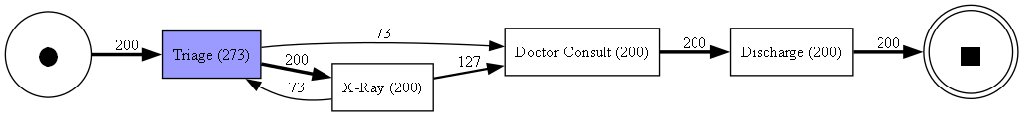
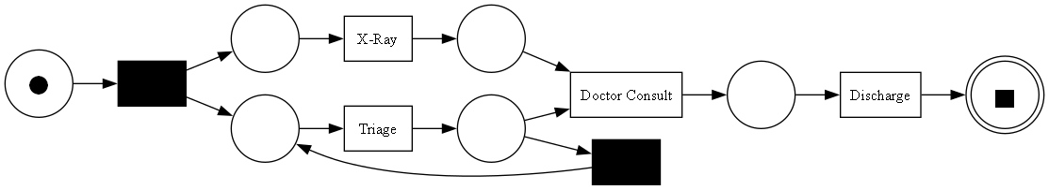
PM4Py Outputs: DFG & Petri Net
1. Directly-Follows Graph (DFG)
2.Petri Net Process Model
The DFG represents activity-to-activity transitions in the patient journey.
It helps us identify:
Common transitions
Process paths
Transition frequencies
Loop-backs
Potentially unusual transitions
Example: Triage → X-Ray → Triage
A Petri Net process model was generated using PM4Py.
The model provides a structured representation of the discovered patient workflow and helps visualize:
Activities
Transitions
Process paths
Repeated process behavior
Possible deviations
The generated Petri Net was successfully verified during the PM4Py workflow testing.

Slide 12

Conformance Checking
Conformance checking was performed to compare actual patient journeys against the expected hospital pathway.
The reference pathway used for the analysis was:
Triage
↓
X-Ray
↓
Doctor Consult
↓
Discharge
Method
Each of the 200 patient cases was compared with the expected pathway.
A case is conformant when its activity sequence exactly matches the defined ideal path.
Additional/repeated activities result in a deviating case.
Purpose
Conformance checking identifies:
Process deviations
Repeated activities

Slide 13

Conformance Findings & Results
Conformance Results
Category | Cases | Percentage
🟢 Conformant | 122 | 61.0%
🔴 Deviating | 78 | 39.0%
Total | 200 | 100%
Key Interpretation
61.0% of cases followed the defined ideal pathway.
39.0% of cases deviated from the expected pathway.
Major observed pattern
Triage → X-Ray → Triage
The 78 deviating cases align with the repeated Triage pattern identified during EDA and process analysis.
Key takeaway
The same 39.0% pattern is observed across multiple stages of analysis.

Slide 14

Root - Cause Investigation
The process analysis identified what happened, while root-cause analysis investigated a possible reason for the loop.
A simulated patient-level field was introduced:
Missing_Paperwork
Results:-
Missing Paperwork | Did Not Loop | Looped
Missing Paperwork | Did Not Loop | Looped
False | 122 | 0
True | 0 | 78
Within the simulated dataset, the association is 100%.
Note: This is a simulated proof of concept and does not prove a real clinical cause.
Status: ✅ Completed

Slide 15

BigQuery + dbt Analytics Cross-Validation
The final event data was integrated into BigQuery and transformed using dbt.
Python results were independently compared with BigQuery/dbt analytics.
The analytics pipeline includes:
stg_hospital_event_log
patient_events
patient_transitions
case_summary
conformance_summary
Data Quality
15 / 15 dbt Tests Passed
0 Errors
0 Warnings
0 Skipped
Status: ✅ Completed
Metric | Python | BigQuery/dbt
Patients | 200 | 200
Deviating Cases | 78 | 78
Deviation Rate | 39.0% | 39.0%
Result: Exact Match ✅
This confirms that the final process deviation result is reproduced across independent analytics implementations.

Slide 16

Power BI Dashboard Patient Drill through
The completed Power BI dashboard provides:
Total Cases.
Total Events.
Conformance %.
Deviating %.
Average Wait Time.
Activity distribution.
Process transitions.
Conformance split.
Bottleneck analysis.
Patient-level drillthrough.
The dashboard is connected to the final BigQuery analytics layer.
Final KPI
Deviating % = 78 / 200 = 39.00%
Status: ✅ Completed and Validated
A Patient Details page was implemented using:
Case_ID
The drillthrough displays:
Case_ID
Activity_Name
Timestamp
The functionality was successfully tested using patient P001.
Status: ✅ Completed and Working

Slide 17
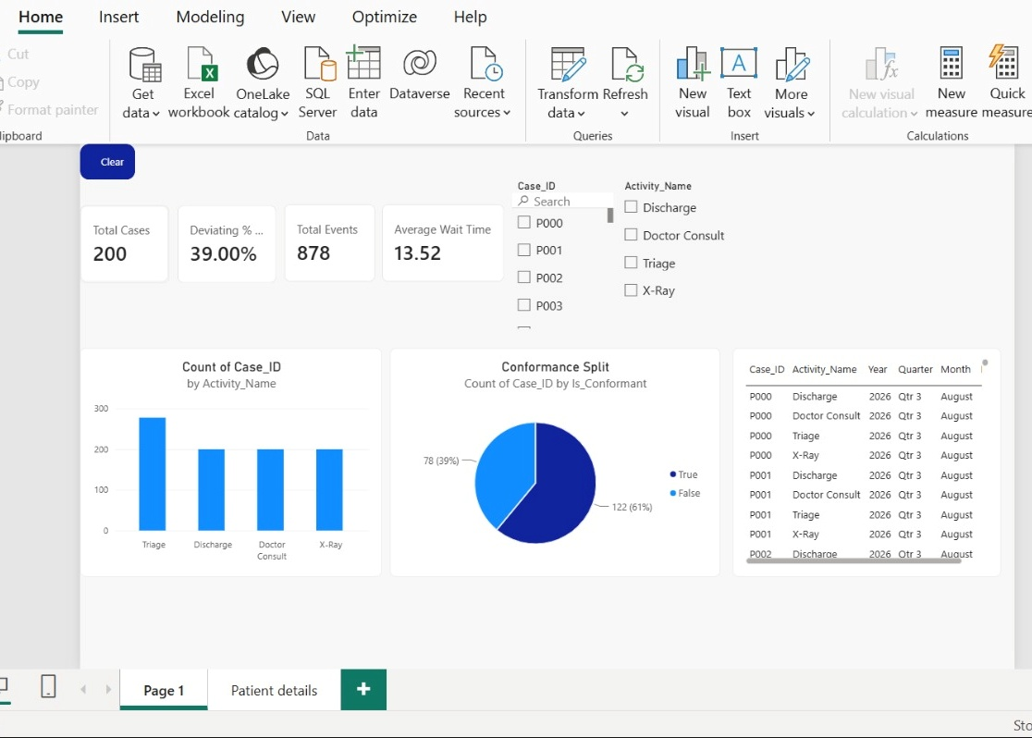

Slide 18
Final Results Key Insights
Patient Cases = 200
Total Events = 878
Conformant Cases = 122 (61.0%)
Deviating Cases = 78 (39.0%)
Main Deviation = Triage → X-Ray → Triage
Average Wait ≈ 13.52 minutes
X-Ray → Triage Wait ≈ 19.95 minutes
dbt Tests = 15/15 Passed
Cross-Validation = Exact Match
Process mining reveals sequence-level patterns that traditional KPIs may hide.
The Triage → X-Ray → Triage loop is the main process deviation.
39.0% of patient cases deviate from the expected pathway.
The simulated root-cause field demonstrates a method for hypothesis testing.
Python and BigQuery/dbt independently produced matching results.
Power BI provides an interactive view of the validated process insights.

Slide 19

Conclusion
CareFlow successfully delivers an end-to-end clinical pathway process-mining workflow.
The project progressed from event generation and data cleaning to process discovery, conformance checking, root-cause investigation, BigQuery/dbt analytics, cross-validation and Power BI reporting.
The final dataset contains 200 patient cases and 878 events. The main process deviation is:
Triage → X-Ray → Triage
This pattern affects 78 out of 200 cases (39.0%).
The final results were independently validated using Python and BigQuery/dbt, and the completed Power BI dashboard provides interactive process insights and patient-level drillthrough.

Slide 20

Thank you

